Slide 1
Denoising-based Diffusion Model Implementation
DDPM, DDIM Implementation using ‘Diffusers’
Presented by Beomsoon Park
C&I LAB

Slide 2
Contents
Introduction
Code Explanation
Sample Results
C&I LAB

Slide 3
Introduction
C&I LAB

Slide 4
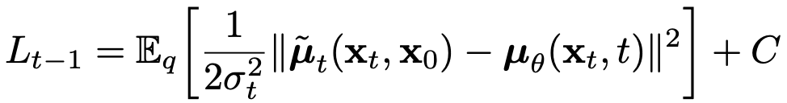
Introduction
DDPM Objective
C&I LAB

Slide 5
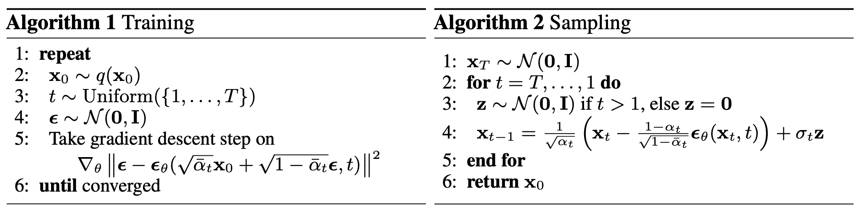
Introduction
DDPM Training & Sampling
Require too many steps for sampling
C&I LAB

Slide 6
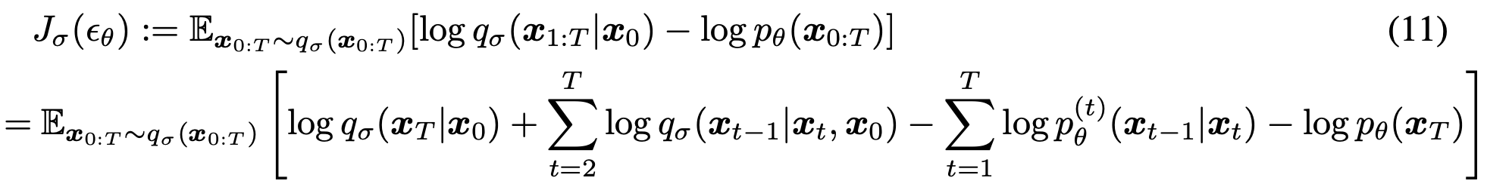
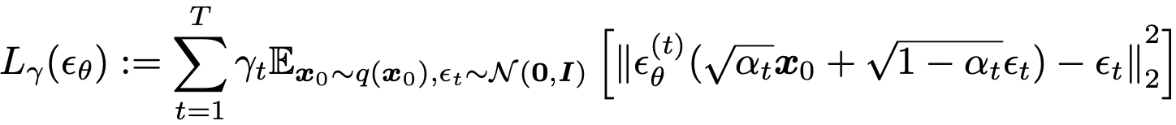
Introduction
DDIM Objective
Optimal solution of $L_{γ}(ε_{θ})$ can be identical to the optimal solution of $J_{σ}(ε_{θ})$
Pre-trained DDPM model is available during sampling with DDIM
C&I LAB

Slide 7
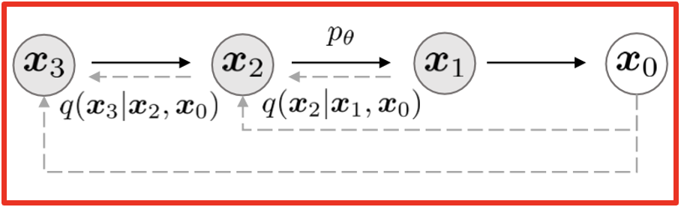
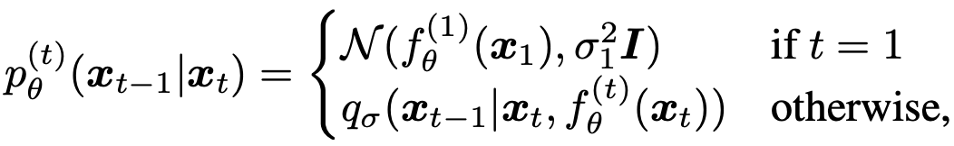
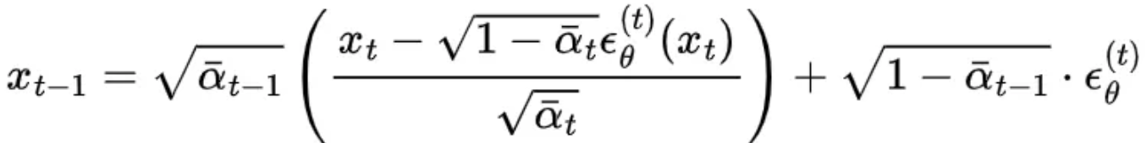
Introduction
DDIM Sampling
C&I LAB

Slide 8
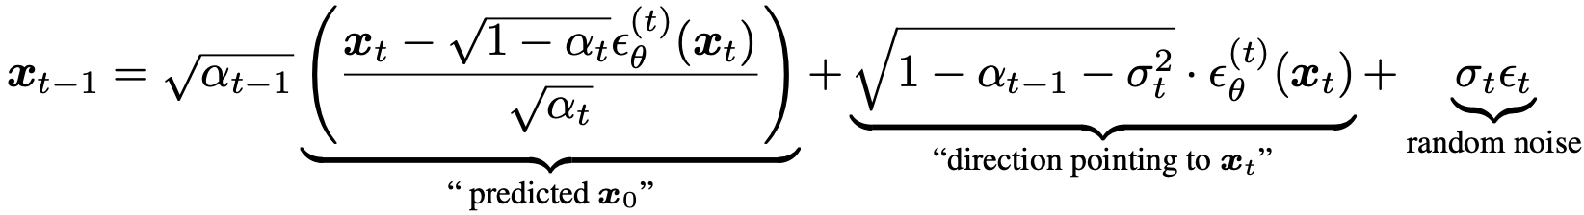
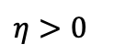
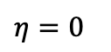
Introduction
DDIM Sampling vs DDPM Sampling
DDPM Sampling
$$η>0$$
$$η=0$$
DDIM Sampling
C&I LAB

Slide 9
Code Explanation
C&I LAB

Slide 10
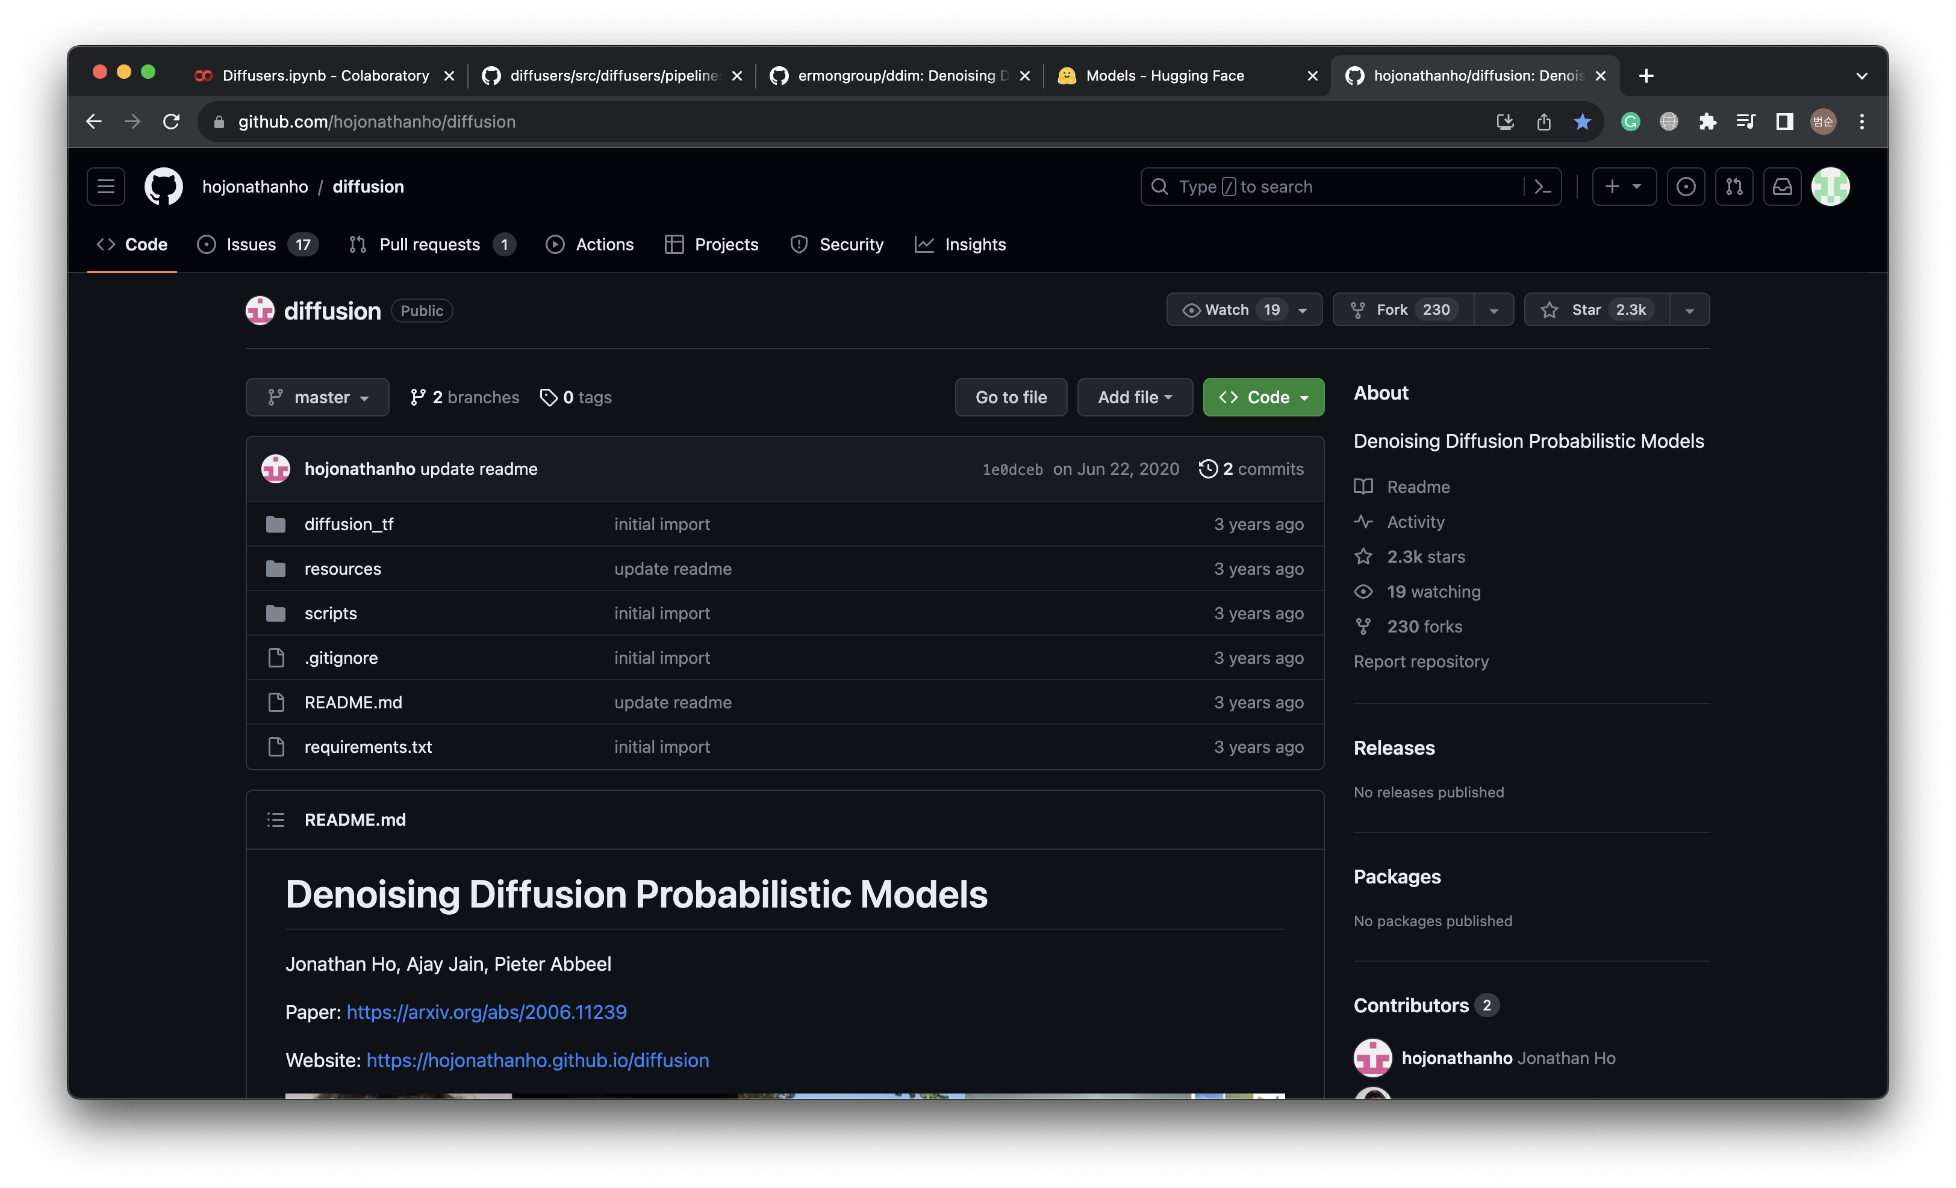
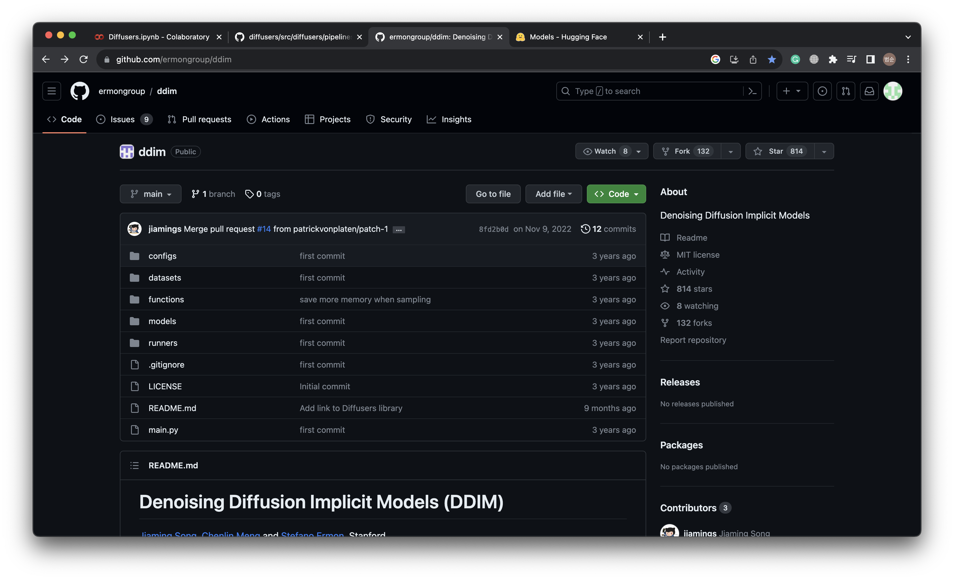
Code Explanation
Original Authors’ Github
Raw Materials
C&I LAB

Slide 11
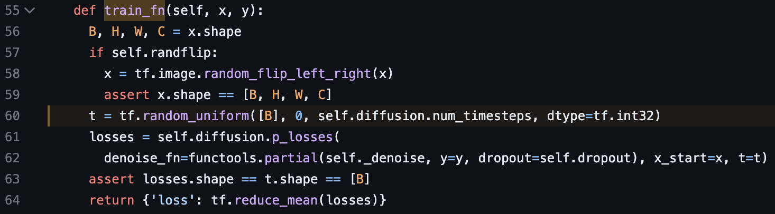
Code Explanation
DDPM Training
C&I LAB

Slide 12
Code Explanation
DDPM Training
C&I LAB

Slide 13
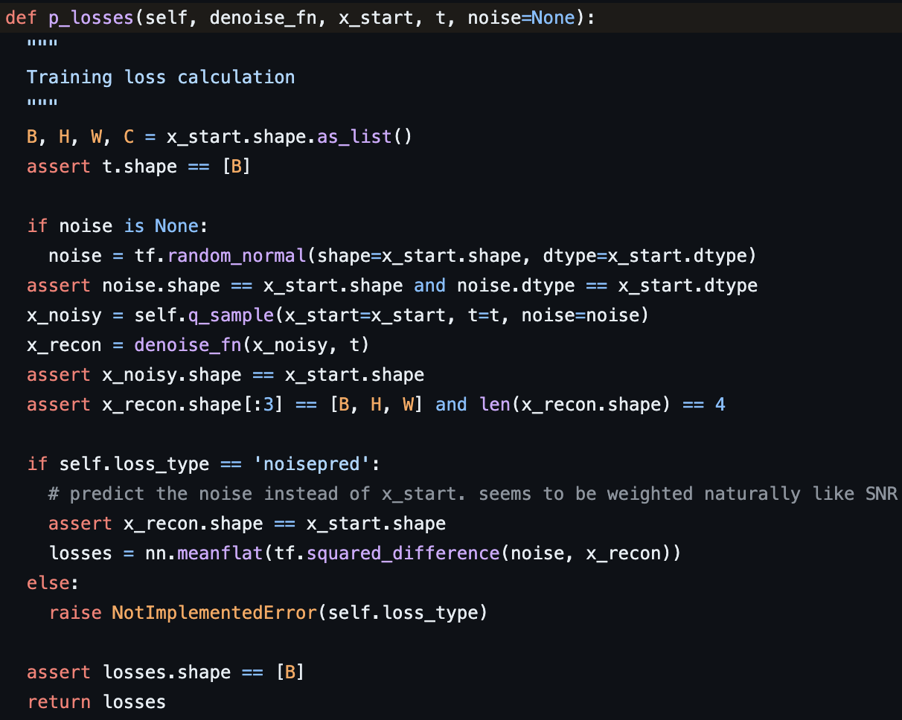
Code Explanation
DDPM Training
C&I LAB

Slide 14
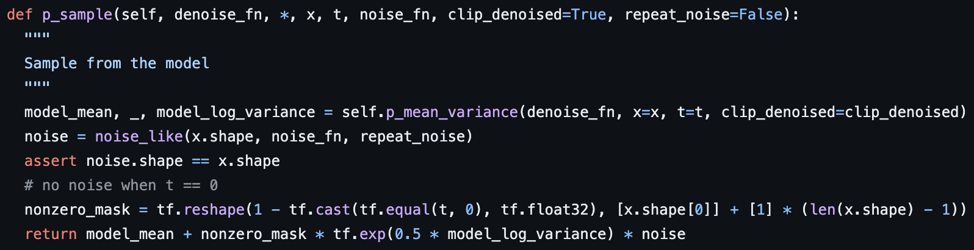
Code Explanation
DDPM Sampling
C&I LAB

Slide 15
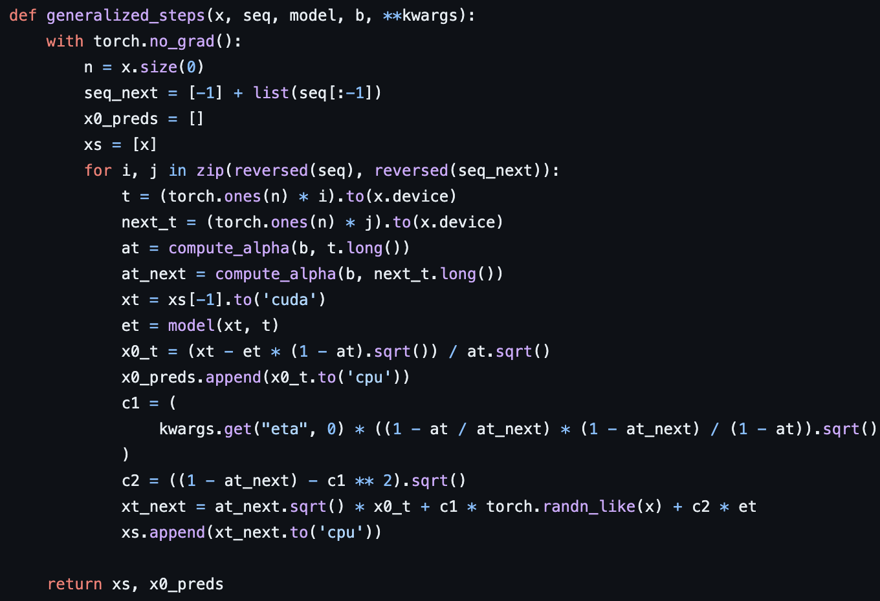
Code Explanation
DDIM Sampling
C&I LAB

Slide 16

Code Explanation
‘Diffusers’ from Hugging Face
Well-defined pipelines for each diffusion model
Easy implementation & Sampling by utilizing pre-trained models for various datasets
https://huggingface.co/docs/diffusers/index
C&I LAB

Slide 17
Code Explanation
‘Diffusers’ from Hugging Face
Pipeline API
Model Configuration
Scheduler
from_pretrained
Load/Save the model
Directly handle
these factors for customization
save_pretrained
C&I LAB

Slide 18
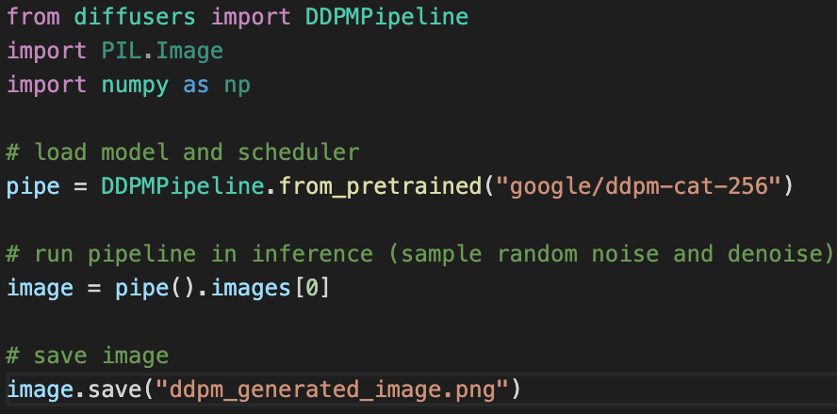
Code Explanation
Sampling by DDPM using DDPM Pipeline
Pretrained Models
Final Sample Image
C&I LAB

Slide 19
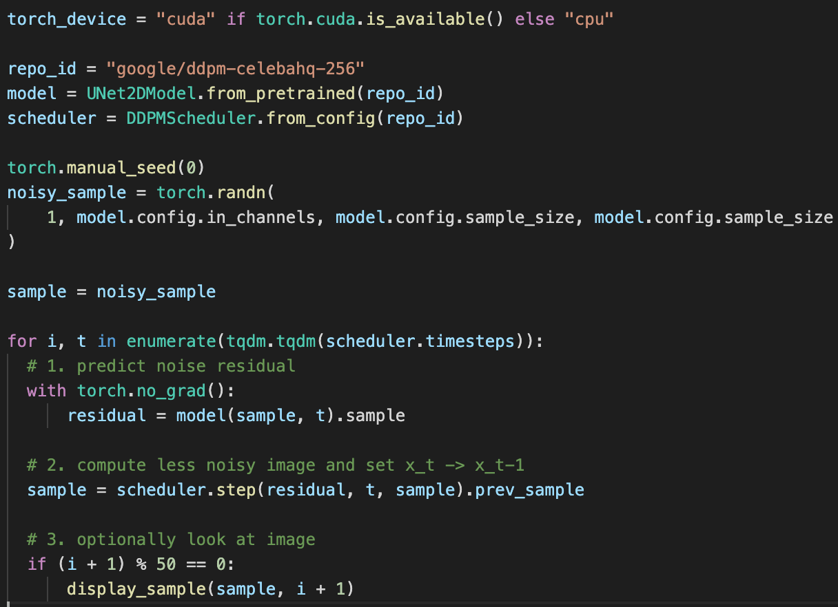

Code Explanation
DDPM Sampling without using pipeline
Pretrained DDPM Model
Initial Sample $x_{T}$
Denoising (Sampling) Steps
C&I LAB

Slide 20
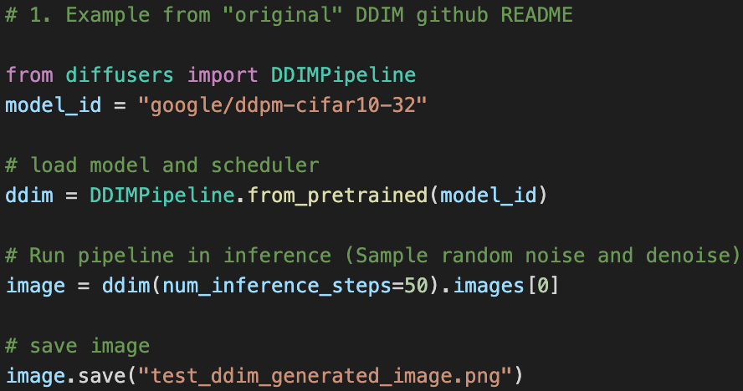
Code Explanation
Sampling by DDIM using DDIM Pipeline
Pretrained Models
Final Sample Image
C&I LAB

Slide 21
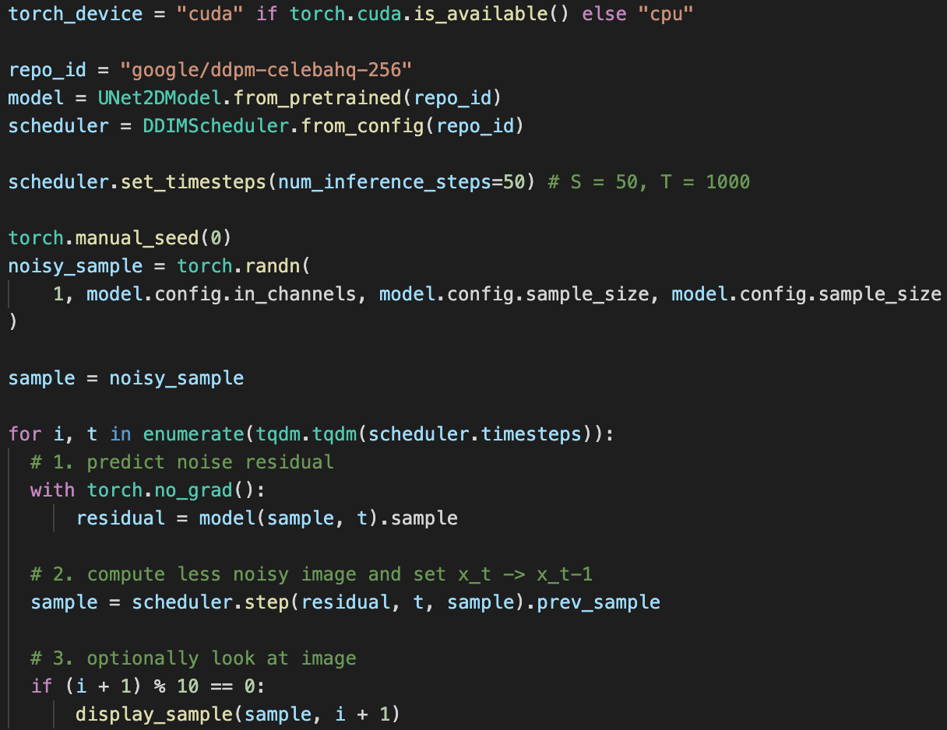

Code Explanation
DDIM Sampling without using pipeline
Pretrained DDPM Model
(Same Training Procedure)
Setting Inference steps
Initial Sample $x_{T}$
Denoising (Sampling) Steps
C&I LAB

Slide 22
Sample Results
C&I LAB

Slide 23
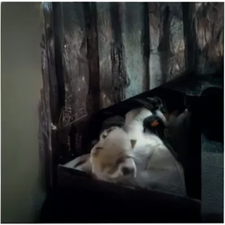
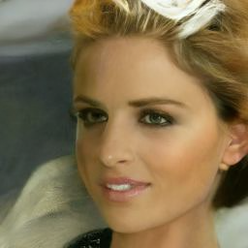
Experiments
DDPM vs DDIM
50 minutes
to complete sampling
(1000 steps)
1 minute and 20 seconds
to complete sampling
(50 steps)
C&I LAB

Slide 24


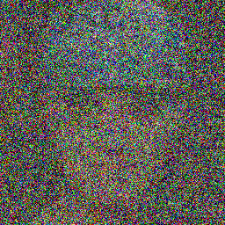
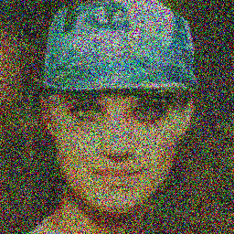
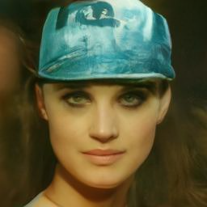
Experiments
DDIM samples
10 steps
20 steps
30 steps
40 steps
50
steps
(Final sample)
C&I LAB

Slide 25
Thank you
C&I LAB

